Slide 1
FINAL PROJECT – ANALYSING MOTOR VEHICLE COLLISIONS/CRASHES IN AUSTING, CHICAGO & NYC
(GROUP 5)
VAISHNAVI VEERKUMAR
PRADNYA SHINDE
ANUSREE MOHANAN
CHIRANJIT BANERJEE

Slide 2
ABOUT THE DATASET
Traffic crash data from New York, Chicago, and Austin is sourced from the Department of Transportation and displayed on each city's respective data portal.
This data provides detailed information about each traffic crash occurring on city streets
Austin has 54 columns and 148k rows
Chicago has 48 columns and 823k rows
NYC has 29 columns and 2.08M rows

Slide 3
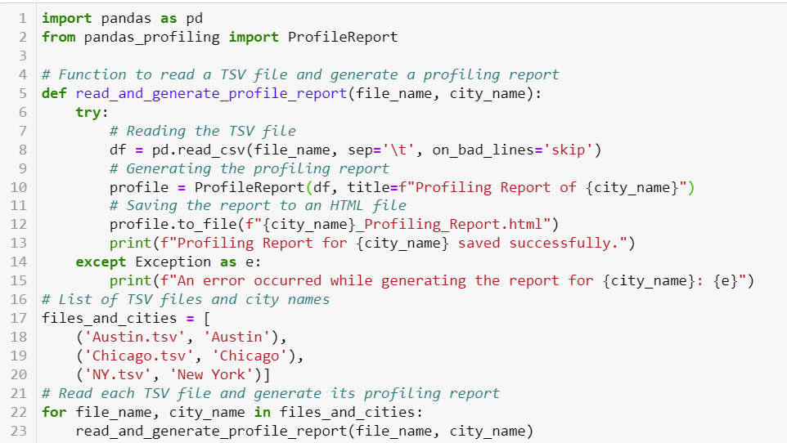
PROFILING THE DATA
Y-Data Profiling python script was used to profile and summarize the nature of the dataset across all the 3 datasets.
Utilized Y-Data Profiling Python script to profile and summarize the characteristics of three datasets, examining their nature comprehensively.
Conducted detailed analysis on each dataset, which included identifying data types and measuring the maximum, minimum, and length of each column.
Evaluated column collinearity and calculated the percentage of missing, distinct and duplicate values for each column.

Slide 4
INCONSISTENCIES IN THE DATA
All the 3 datasets had missing values which were properly handled :
NA for categorical data and –1 for numerical data.
Boolean data were handled and replaced with ‘Y’ and ‘N’ accordingly
Special characters were present in many columns like : “/ , & ,‘, # , @, ‘ , -”

Slide 5
STAGING-CLEANING-NORMALIZING THE DATA
AS-IS Stage: Defined the format for date column and Adjusted the precision of latitude and longitude values. Loaded the data from .tsv file to SQL database.
Cleaning stage : Data cleaning tasks included substituting missing values with NA for categorical and -1 for numeric data type.
Normalizing Data stage: According to the business requirement we have to map contributing factor codes and contributing factor codes to its crash_id / collison_id.
Austin: Merged 'contrib_factr_p1_id' and 'contrib_factr_p1_id' into a single 'contributing_factor_code' column per crash, using only non-null values mapped to descriptions from the mapping sheet.
Chicago: Split 'PRIM_CONTRIBUTORY_CAUSE' and 'SEC_CONTRIBUTORY_CAUSE' into two rows per crash, avoiding duplicates.
NYC: Normalized five columns related to vehicle contributing factors into new rows for each collision ID. Verified contributing factor values against a mapping document to utilize corresponding codes and descriptions.
Additional Adjustments: Performed minor changes in the staging table following a later change request.

Slide 6
CHANGE REQUEST
NYC Data Normalization:
Normalize five columns related to vehicle types involved in collisions.
Each collision ID will have associated vehicle types listed in new rows during the data cleansing phase.
Vehicle type values are verified against a created mapping document, with corresponding codes and descriptions used in the final staging.
Austin Data Normalization:
Normalized vehicle data according to business requirements specified in a change request.
Added 'Vehicle_Code' to separate each unit involved in crashes into distinct rows.
Each vehicle/unit is mapped to the least granular 'Vehicle_Description' from the vehicle mapping sheet for detailed results.
CHICAGO Data Normalization :
There was no detail regarding vehicles involved in crash particularly.

Slide 7
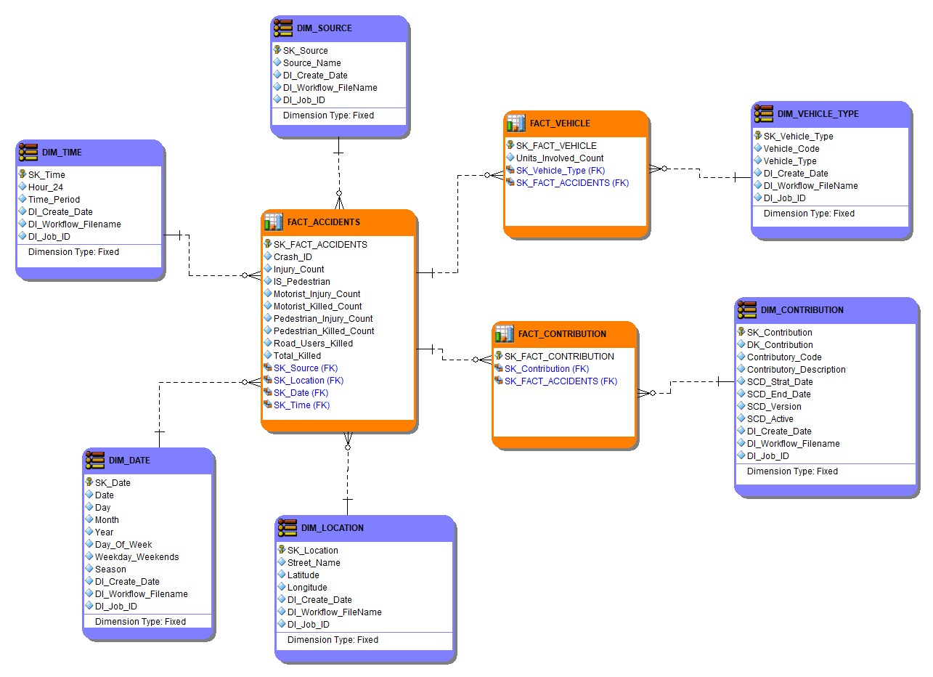
DIMENSION MODEL

Slide 8
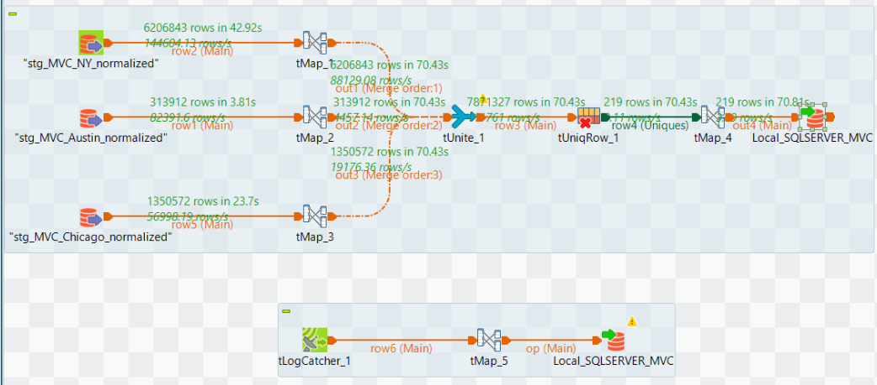
DIMENSIONS AND FACTS
LOADING DIM_VEHICLE_TYPE

Slide 9
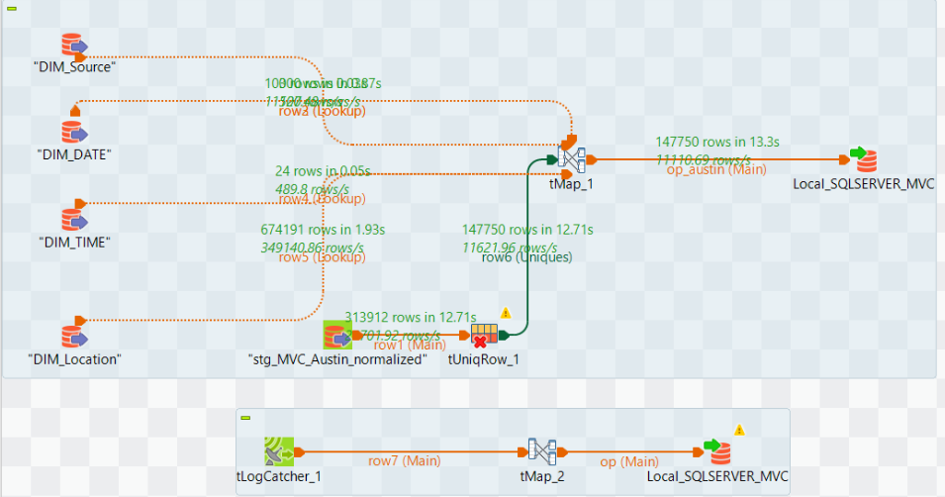
Contd …
LOADING FACT_ACCIDENTS

Slide 10
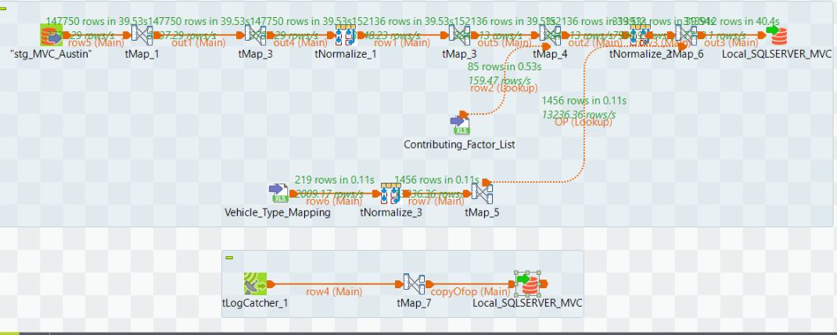
AUDITING LOG
AUSTIN NORMALIZED WORKFLOW

Slide 11
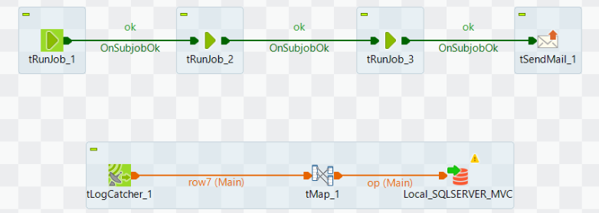
JOB ORCHESTRATION
Used job orchestration to automate the task of loading to fact tables.
Additional Feature :
Ones the fact is loaded, an e-mail notification is received be the user on successful completion of the job.

Slide 12
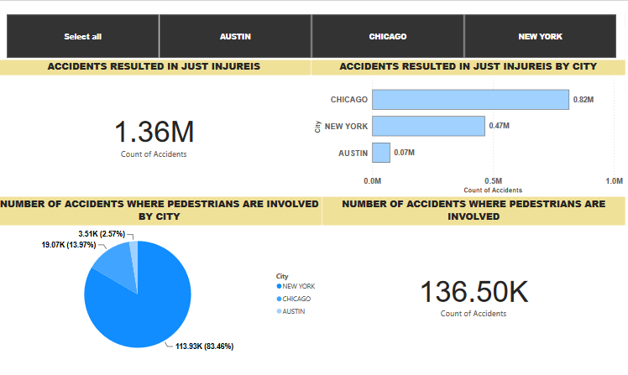
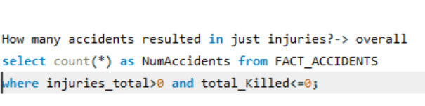
SQL QUERY AND VISUALIZATION

Slide 13
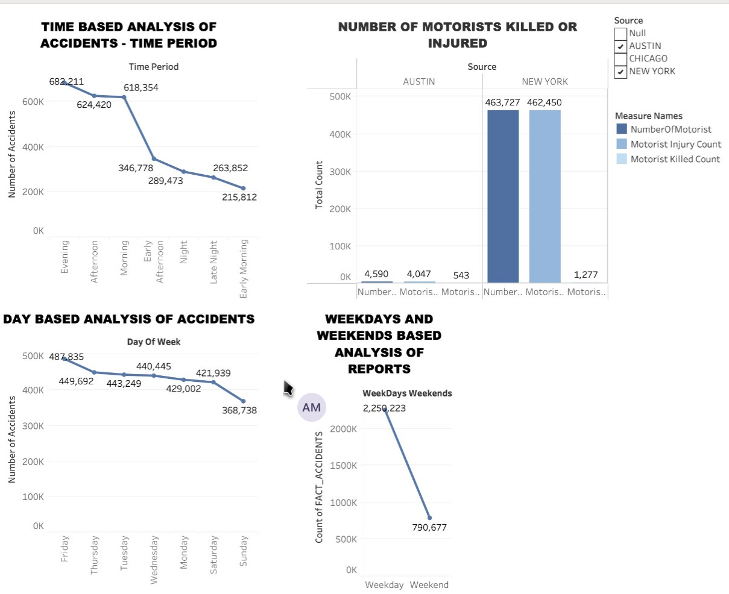
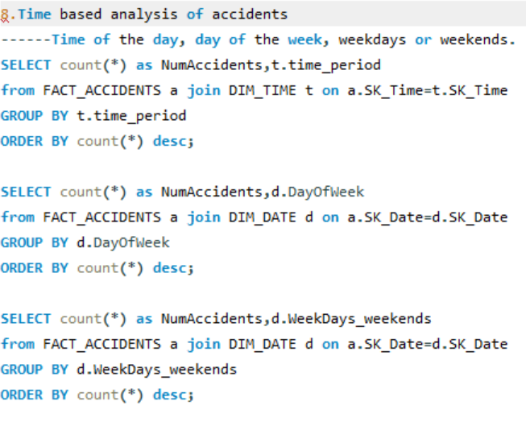
VISUALIZATIONS AND SQL QUERIES

Slide 14
CONTRIBUTIONS
DATA PROFILING : Chiranjit Banerjee
AUSTIN : Anusree Mohanan
CHICAGO : Vaishnavi Veerkumar
NYC : Pradnya Shinde
DATA MODELING : Team Effort
DATA VISUALIZATION + SQL QUERIES : Team Effort

Slide 15
THANK YOU

